Slide 1
Old Car Price Prediction
By: Rakhym Taskyn
Supervisor:Dr Bashir Alam
Mtech 2nd year I Semester

Slide 2
Problem Description(1)
Between 2008 to 2017, 630 million cars produced in the world
Cars in use in 2017 is 1.1 billion.
Most of developed countries has limitation period for vehicles, 10 years from manufacture date.
In developing countries this limit is between 15 to 30 years.
In the world we have 470 million old cars

Slide 3
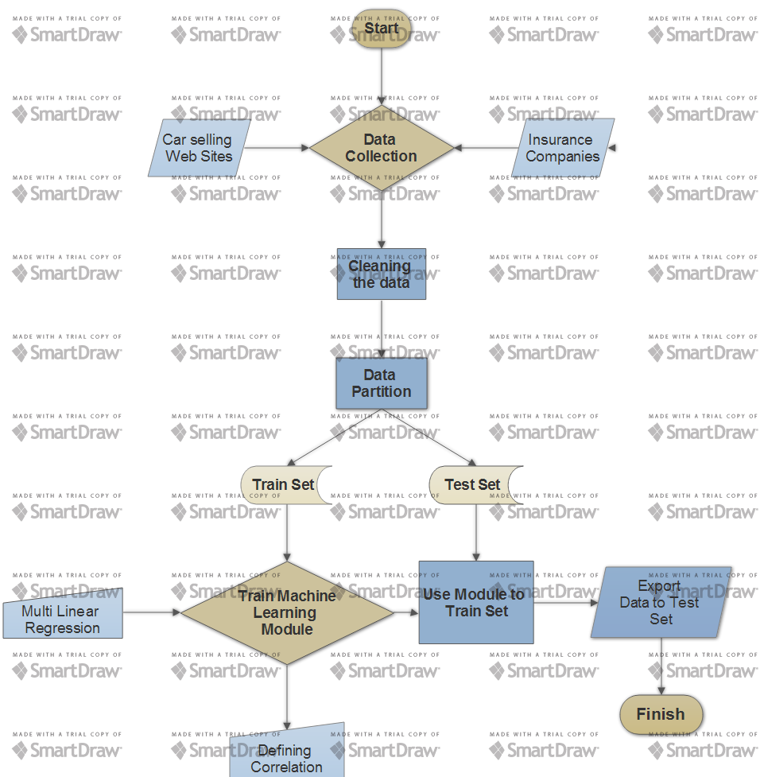
Workflow Diagram

Slide 4
Problem Description(2)
From developed countries each year millions cars exported to developing world.
Unlike new vehicle, old vehicle’s price not stable.
There are different factors which influences to price of used car.

Slide 5
Factors which influences to price of used car
Manufacture date
Passed distance
How many owners had
Engine type
History of replaced parts
Crash details (if had)

Slide 6
Traditional method
Simple statistical method.
Calculation of mean value of cars by years and other characteristics
Creating very huge database to compare
Very ineffective
Very much time and resource consuming

Slide 7
New solution by using Machine Learning
Young branch of Computer Science
Uses Supervised learning to learn cars parameters and prices from Train set.
By using Polynomial Regression we train our module from train set.
Using this module to test set for predicting price of old car

Slide 8
Data set explonation
Dataset consist 2 parts
1. Train set, where cars characteristics and our target, cars price.
2. Test set, where we have only cars characteristics.
Our task is to predict cars price in Test set

Slide 9
Data preprocessing
Data Scientists says that preprocessing is 70% of all module training job in Machine Learning
1. I labeled as numeric to characteristic values which given by words. I replaced them into integer numbers.
2.Identifing dependency of dependent value from independent values
3. I removed unnecessary patterns which does not influences on Vehicles price. Such as Fuel Type, Body Type, Transm Type

Slide 10
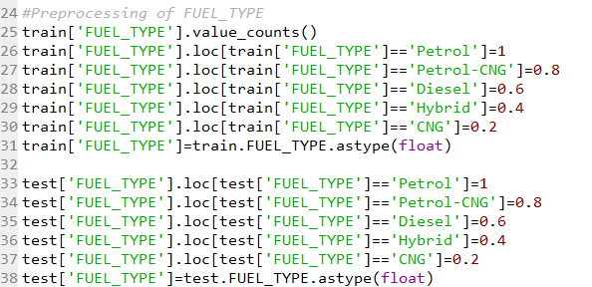
How to label text to numeric value?

Slide 11
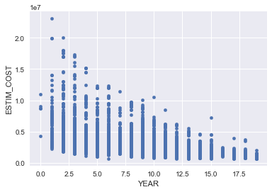
Dependency of Estimated_Cost to Year of Usage(Corr=-0.45)

Slide 12
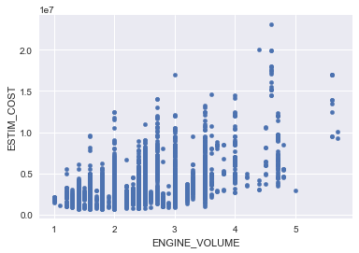
Dependency of Estimated_Cost to Engine Volume(Corr=0.48)

Slide 13
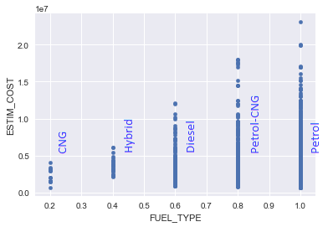
Dependency of Estimated_Cost to Fuel Type(Corr=0.07)

Slide 14
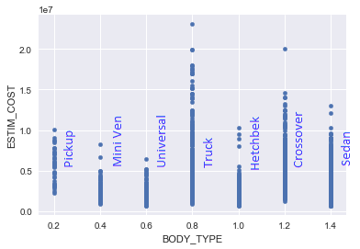
Dependency of Estimated_Cost to Body Type(Corr=-0.18)

Slide 15
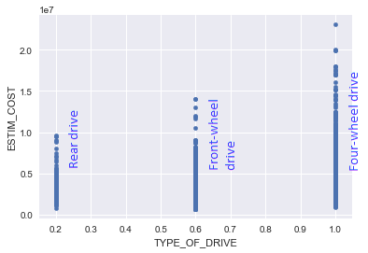
Dependency of Estimated_Cost to Type of Drive(Corr=0.32)

Slide 16
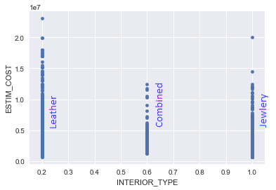
Dependency of Estimated_Cost to Interior Type(Corr=-0.31)

Slide 17
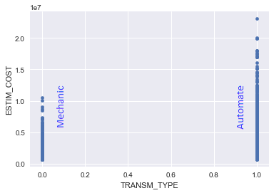
Dependency of Estimated_Cost to Transmission Type(Corr=0.22)

Slide 18
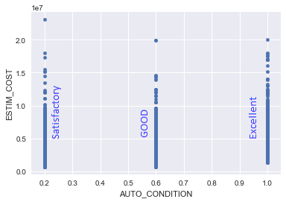
Dependency of Estimated_Cost to Auto Condition(Corr=-0.3)

Slide 19
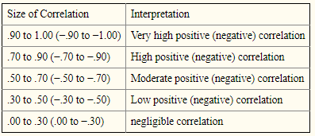
Which features should be Extracted?
The Rule of Thumb says: If

Slide 20
Which features should be Extracted?
According to Rule of Thumb extractable features are:
Fuel Type(Corr=0.07)
Body Type(Corr=-0.18)
Transmission Type(Corr=0.22)

Slide 21
How to do feature extraction?
It is very simple python pandas has function drop.
train.drop(['FUEL_TYPE','BODY_TYPE','TRANSM_TYPE'],axis=1,inplace=True)
test.drop(['FUEL_TYPE','BODY_TYPE','TRANSM_TYPE'],axis=1,inplace=True)

Slide 22
Making price prediction Module
As we have multiple independent values which effects to out independent values:
Also our task is regression (not classification)
We are using Multiple Linear Regression

Slide 23
What is Multiple Linear regression?
Multiple Linear regression(MLR) – most common type of Linear regression analysis. As a predictive analysis, MLR used to explain the relationship between one continuous dependent variable and two or more independent variables. The independent variables can be continuous or categorical.

Slide 24
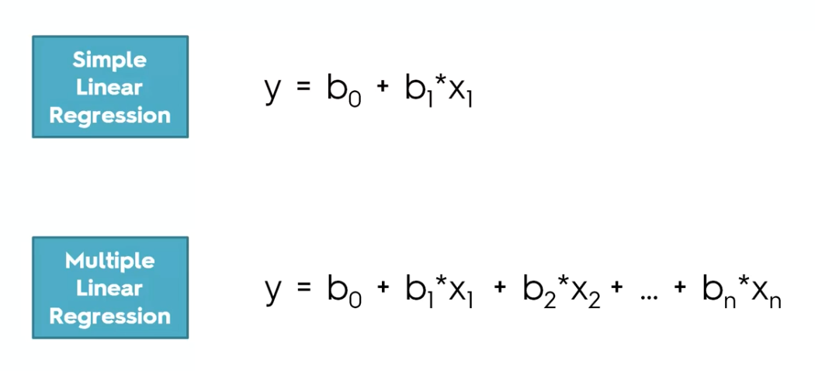
What is Multiple Linear regression?

Slide 25
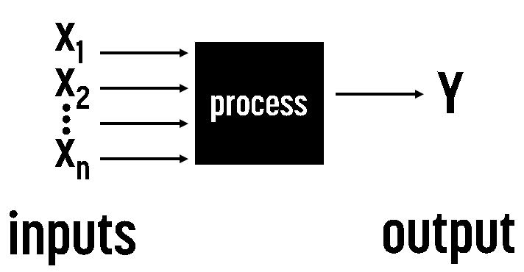
What is Multiple Linear regression Blog Diagram?

Slide 26
How to make Multiple Linear Regression Module in Python?
It is very Simple, as follows :
1. Importing Library:
fromsklearn.linear_model import LinearRegression
2.Creating new regression:
regressor=LinearRegression()
3.Training module from train dataset:
regressor.fit(X_train,y_train)
4.Using trained regression module to test set:
predPrice=regressor.predict(test)
5. Saving our predicted values to new CSV:
predPrice.to_csv('testCar_Estimated price.csv')

Slide 27
How to check our accuracy?
1.We are dividing our train set into sample train set and sample test set in the ratio of 8:2: from sklearn.cross_validation import train_test_split
X_train,X_test,y_train,y_test=train_test_split(X,y,test_size=0.2,random_state=0)
2.First we will train our model from sample train test:regressor.fit(X_train,y_train)
3.We use our model to predit sample test set: y_pred=regressor.predict(X_test)
4. As we already know our y_test we are checking correlation between y_test and y_pred it gives us accuracy: exp['y_pred'].corr(exp['y_test'])
5. Correlation is: 0.828 means accuracy =82.8%

Slide 28
What we have achieved?
Year of Usage(Corr=-0.45)
Engine Volume(Corr=0.48)
Type of Drive(Corr=0.32)
Interior Type(Corr=-0.31)
Auto Condition(Corr=-0.3)
Multiple Linear Regression
Corr=0.82

Slide 29
Comparing my accuracy with other Researches.
# | Researchers Experience | Accuracy
1 | Support Vector Regression Analysis for Price Prediction in a Car Leasing Application. Thesis (MSc). Hamburg University of Technology. | 0.81
2 | Predicting the Price of Used Cars using Machine Learning Techniques 1Computer Science and Engineering Department, University of Mauritius. | 0.82
3 | My result | 0.828

Slide 30
References
Predicting the Price of Used Cars using Machine Learning Techniques, International Journal of Information & Computation Technology. ISSN 0974-2239 Volume 4, Number 7 (2014), pp. 753-764
http://www.statisticssolutions.com/what-is-multiple-linear-regression/
https://www.ncbi.nlm.nih.gov/pmc/articles/PMC3576830/
https://en.wikipedia.org/wiki/Linear_regression#Simple_and_multiple_linear_regression
https://pandas.pydata.org/pandas-docs/version/0.18/generated/pandas.DataFrame.html
https://en.wikipedia.org/wiki/Correlation_and_dependence
Using machine learning algorithms for housing price prediction: The case of Fairfax County, Virginia housing data, journal homepage: www.elsevier.com/locate/eswa

Slide 31
Thank You, For your attention

